Slide 1

FALL DETECTION - METHODLOGY
By Eden Amram and Ziv Shamli

Slide 2

METHODOLOGY OVERVIEW
The study consists of two main phases:
Phase 1- Evaluation of generative models & synthetic data creation
Evaluate generative models for producing realistic images of public spaces.
Create synthetic fall data using the best-performing models for the fall-detection stage.
Phase 2 - Real-time fall detection with LBFD-Net :
Assess the contribution of the synthetic data to improving detection accuracy and generalization to new environments.

Slide 3
PHASE 1: EVALUATING GENERATIVE MODELS
Two comparison tracks:
Track A - Text-to-Image models
Track B - Image-to-Image (img2img) models
Purpose: Identify the most realistic and stable models for public-space image generation.

Slide 4
TRACK A: TEXT-TO-IMAGE SETUP
Public-Space Fall Generation
In Track A, each generative model produced:
10 images
Based on the same textual description of a fall event occurring in a public space
Objective:
Evaluate the ability of text-to-image models to generate physically coherent and structurally consistent fall scenarios suitable for synthetic dataset creation.

Slide 5
TRACK A: EVALUATION STRATEGY
Generated images were evaluated using a combination of:
Physical consistency metrics (primary focus)
Perceptual quality metrics (secondary focus)
This prioritization reflects the importance of physical realism when synthetic data is intended for training fall detection models.

Slide 6
TRACK A: PHYSICAL METRICS (HIGH PRIORITY)
The following physics-based metrics were used:
Depth Consistency - Measures spatial coherence of scene depth, ensuring correct relative positioning of the human body, background, and surrounding objects.
Shading Consistency- Evaluates alignment of shadows with scene lighting, including direction, intensity, and placement. Detects inconsistencies such as shadows that do not match body pose or light source.
Surface Normals Consistency (Normals)- Assesses the consistency of surface orientations, ensuring geometrically plausible objects and human figures without distortions.

Slide 7
TRACK A: PERCEPTUAL METRICS (SECONDARY PRIORITY)
Reference-Free Quality Assessment
After physical consistency evaluation, images were further assessed using:
NIQE – Naturalness based on statistical image properties
BRISQUE – Local spatial distortion and image quality
MA Score – Aesthetic quality and visual composition

Slide 8
TRACK A: EVALUATION HIERARCHY
Metric Prioritization
Physical consistency metrics
Depth
Shading
Normals
NIQE
BRISQUE
MA Score
Rationale:
Physical and structural fidelity is critical for reliable fall detection training data
Perceptual and aesthetic quality is considered only after physical plausibility is ensured

Slide 9
TRACK B: IMAGE-TO-IMAGE SETUP
Reference-Guided Generation
In Track B:
Each model generated 10 images
Based on reference images depicting a person falling or not falling in public spaces
Objective:
Evaluate realism and physical consistency when models are guided by visual input.

Slide 10
LIMITATIONS OF REFERENCE-BASED METRICS
Why PSNR, SSIM, and KID Were Excluded
Although commonly used, reference-based metrics such as:
PSNR
SSIM
KID
were not suitable for this task.
Reason:
Generated images introduce new and significant scene content
Low scores reflect legitimate variation, not poor quality
These metrics penalize diversity rather than rewarding realism

Slide 11
TRACK B: PHYSICAL METRICS (HIGH PRIORITY)
Physics-Based Realism Evaluation
The same physics-aware metrics were prioritized:
Depth Consistency -Ensures logical 3D integration of body pose, fall dynamics, and scene layout.
Shading Consistency- Validates correct interaction between lighting and geometry.
Surface Normals Consistency (Normals)- Confirms geometric plausibility and absence of structural distortions.

Slide 12
TRACK B: SECONDARY PERCEPTUAL METRIC
Overall Visual Quality
NIQE- Used as a reference-free perceptual metric to ensure generated images maintain natural image statistics.

Slide 13
TRACK B: EVALUATION SUMMARY
Design Principles
This evaluation framework:
Emphasizes realism and physical plausibility
Avoids misleading reference-based fidelity metrics
Maintains perceptual quality without sacrificing structural correctness
Outcome:
Provides a reliable basis for selecting generative models suitable for Image-to-Image fall detection dataset generation.

Slide 14
Models | ↓NIQE | ↓BRISQUE | Normals C. | Shading C. | Depth C. | ↑MA Score
Stable Diffusion v1.5 | 3.271 | 17.474 | 0.03 | 0.444 | 0.39 | 5.862
Stable Diffusion | 3.824 | 33.675 | 0.0298 | 0.54 | 0.37 | 5.864
Stable Diffusion XL | 3.764 | 15.504 | 0.037 | 0.446 | 0.37 | 5.789
Kandinsky 2.2 | 4.495 | 36.117 | 0.033 | 0.428 | 0.346 | 6.094
Nano Banana | 2.686 | 22.225 | 0.031 | 0.514 | 0.371 | 5.778

Slide 15

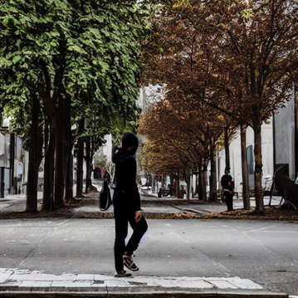




Stable Diffusion v1.5
Stable Diffusion XL
Kandinsky 2.2

Slide 16

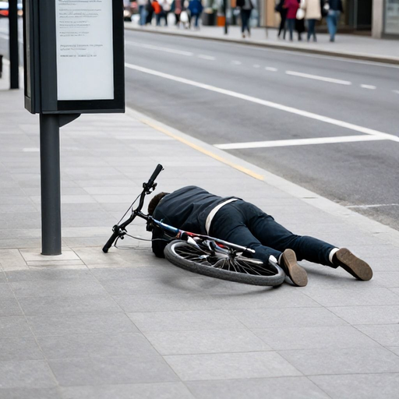

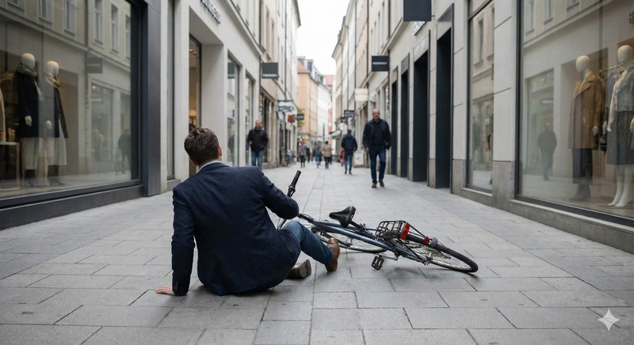
Stable Diffusion
Nano Banana

Slide 17
TRACK B: IMAGE-TO-IMAGE (IMG2IMG)
Each model generates 10 images based on one reference image.
Images are evaluated without a reference using:
KID - Kernel Inception Distance
PSNR - Signal-to-noise fidelity
SSIM - Structural similarity
The best-performing models are selected for the next phase.

Slide 18
Models | ↓NIQE | Normals C. | Shading C. | Depth C.
Stable Diffusion v1.5 | 2.372 | 0.273 | 0.479 | 0.31
Stable Diffusion XL + VAE | 6.431 | 0.033 | 0.51 | 0.31
Masked Stable Diffusion XL | 5.903 | 0.033 | 0.51 | 0.31
ChatGPT 5 | 4.945 | 0.044 | 0.348 | 0.454
Nano Banana | 2.536 | 0.028 | 0.491 | 0.31
inpaint | 3.158 | 0.031 | 0.497 | 0.363

Slide 19
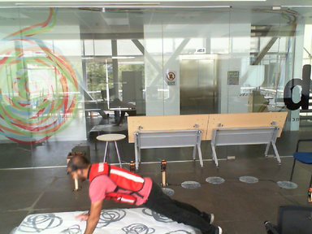
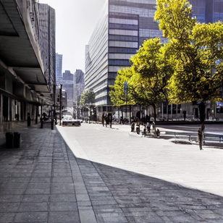
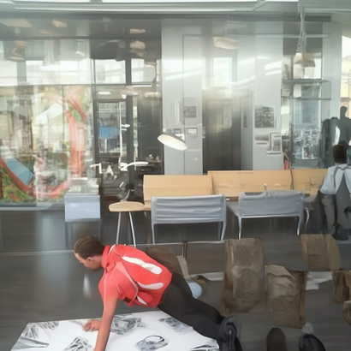

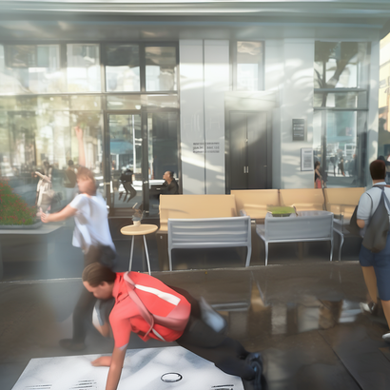
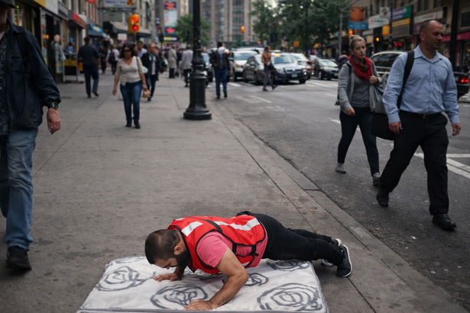
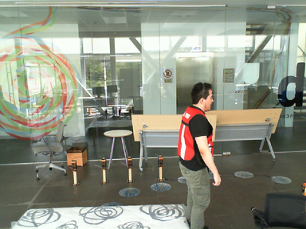


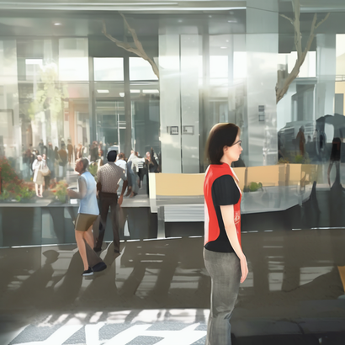
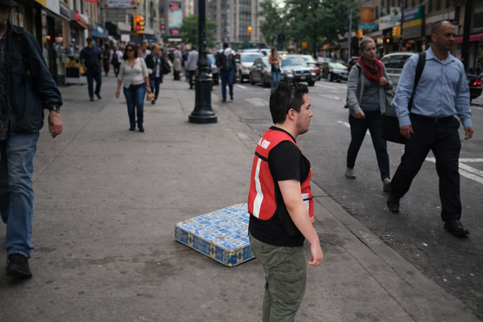
Ref
Stable Diffusion v1.5
Stable Diffusion XL
Mask
Masked Stable Diffusion XL
ChatGPT 5

Slide 20
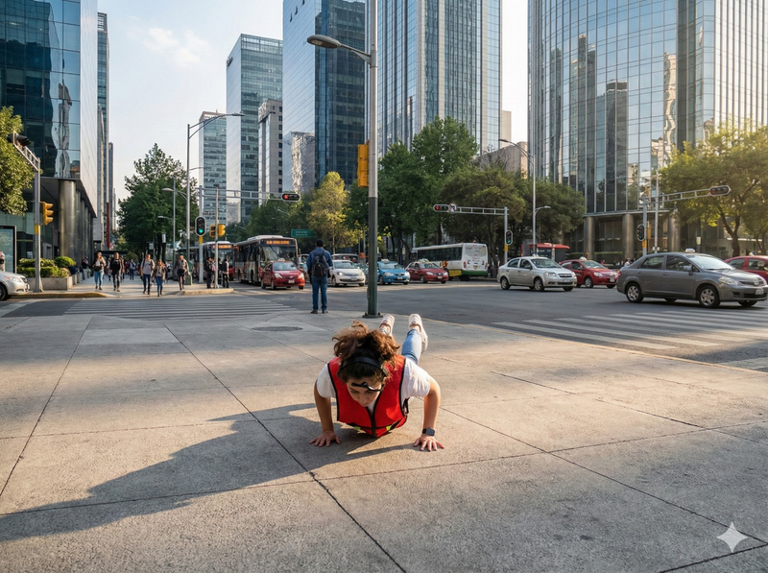
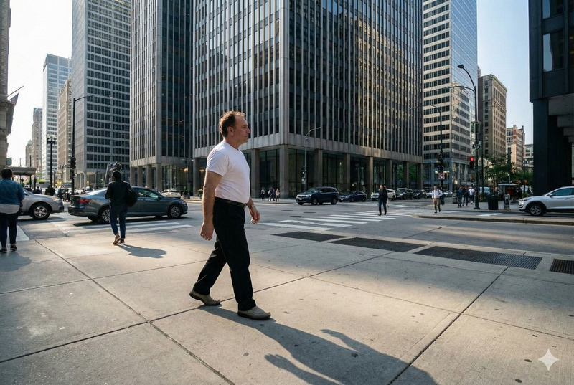
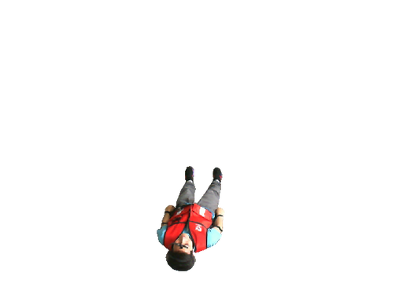
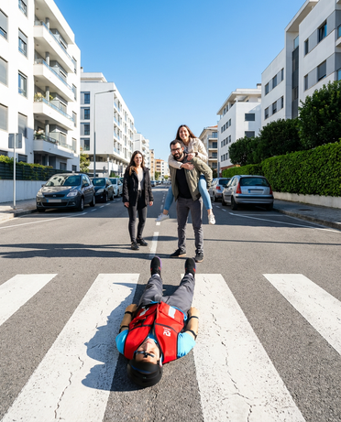
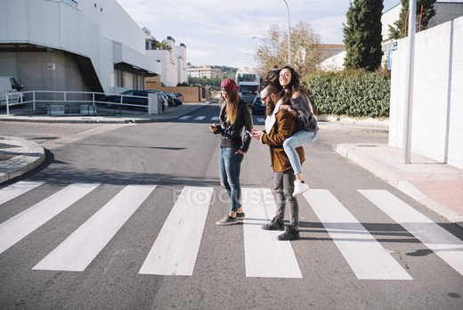
Nano Banana
inpaint
+
=

Slide 21
MODEL SELECTION & SYNTHETIC DATASET CREATION
Top Text-to-Image model selected from Track A
Top Image-to-Image models selected from Track B
Using these models(from each ):
Generate 300-350 synthetic images, including falls and non-falls
Label each image accordingly for fall-detection training
Scenes reflect public spaces: streets, sidewalks, parks, crowds, and variable lighting
Images serve as the synthetic dataset for the fall-detection stage

Slide 22
PHASE 2: FALL DETECTION USING LBFD-NET
After generating the synthetic dataset, the second phase focuses on evaluating LBFD-Net under different training conditions.
Goal:
Assess how different training datasets affect performance on both laboratory and synthetic public-space environments.

Slide 23
TRAINING DATASET OVERVIEW
LBFD-Net Training Data Composition
Four different training datasets were used to evaluate the impact of real versus synthetic data on fall detection performance:
One real laboratory dataset
Three independent synthetic datasets generated using different generative models
300- 350 manually labeled images per dataset
Each dataset was used to train a separate LBFD-Net model.

Slide 24
LABORATORY-ONLY TRAINING SET
Real Controlled Environment Data
This dataset contains only real fall and non-fall images captured under controlled laboratory conditions.
Key Characteristics:
Stable and uniform lighting
Fixed camera positions
Simple, uncluttered indoor backgrounds
No crowds or outdoor elements
Purpose:
Represents the traditional experimental setup commonly used in fall detection research
Serves as a baseline for in-domain performance

Slide 25
DATASETS 2-4: SYNTHETIC TRAINING SETS
Generative Model–Based Datasets
Each generative model selected in Phase 1 produced an independent synthetic dataset.
Dataset Details:
300–350 manually labeled synthetic images per dataset
One dataset per generative model
Fall and non-fall scenarios included

Slide 26
CHARACTERISTICS OF SYNTHETIC DATASETS
Simulated Public-Space Conditions
Each synthetic dataset includes:
Diverse indoor and outdoor backgrounds
Variable and non-uniform lighting conditions
Multiple people present in the background
Naturalistic and unconstrained fall poses
Motivation:
Simulates uncontrolled public environments
Addresses the impracticality and ethical challenges of collecting real fall images in public spaces

Slide 27
UNIFIED TEST SET
Consistent Evaluation Across Models
All four LBFD-Net models were evaluated using a single unified test set.
Construction Principles:
Images sourced from both laboratory and synthetic datasets
Only images not used during training were included
Ensures fair and consistent comparison between models

Slide 28
TEST SET COMPOSITION
Evaluation Scenarios
The unified test set consists of two subsets:
Real Laboratory Test Images
Unseen real indoor images
Used to evaluate in-domain and controlled-environment performance
Synthetic Public-Space Test Images
Unseen synthetic images
Designed to mimic real-world public environments

Slide 29
EVALUATION OBJECTIVE
Assessing Generalization Capability
This evaluation setup enables:
Direct comparison of models trained on different data types
Analysis of domain shift between laboratory and public-space environments
Measurement of how synthetic data influences the generalization performance of LBFD-Net

Slide 30
EVALUATION METRICS
Each trained model is evaluated using:
Classification Metrics
Accuracy
Precision
F1-Score
Curve-Based Metrics
ROC Curve
AUC Score

Slide 31
Models | Accuracy | Precision | F1-Score
LBFD Net - Lab (Dataset1)
LBFD Net - Dataset2
LBFD Net - Dataset3
LBFD Net - Dataset4

